Slide 1
Virginia’s Unified VQB5 System 2023-2024
Info Session for MCCYN/MCCYN-Plus Programs in Virginia- August 8, 2023

Slide 2
Our Shared Vision
We envision a Virginia where all children have the opportunity to enter school ready.
All families have affordable access to and support to choose the option that meets their unique needs.
All early childhood programs that take public funds benefit from measurement and supports for improvement, ensuring quality choices are available for all families.
Programs are rewarded for continual improvement and educators are adequately compensated.
Overall Virginia’s early childhood system is unified, data-driven, and resource-effective so families can work, go to school, or pursue employment and children have every opportunity to be successful.
Four out of ten Virginia children enter school without the key literacy, math, and social-emotional skills needed. (VKRP fall 2022)
Notes:
Erin

Slide 3
VQB5 Theory of Change
To prepare all children for kindergarten, Virginia’s early childhood system must ensure they have access to quality teaching and learning experiences that meet their unique needs.
Working together, through VQB5, Virginia will:
UNIFY around shared and equitable expectations for quality.
MEASURE and strengthen teacher-child interactions and curriculum use in all publicly-funded birth-to-five programs.
IMPROVE supports for educators, prioritizing those who need it most.

Slide 4
VQB5: Unified Measurement and Improvement
In response to state law, the Virginia Board of Education has established a unified measurement and improvement system (VQB5), for all publicly-funded birth-to-five early childhood programs.
The VDOE piloted and then scaled VQB5, working with multiple stakeholders and communities to develop the new system.
VQB5 included two Practice Years.
In the fall 2023, all publicly-funded birth-to-five programs, will be required to participate in VQB5, with the first quality ratings published in fall of 2024.
This will include ~3,600 schools, child care, and family day home programs with ~12,000 "classrooms."
The 2023-2024 VQB5 Guidelines received a full endorsement from the Early Childhood Advisory Committee and were approved by the Board of Education on June 15, 2023.
Notes:
Erin

Slide 5
Supporting Families
Families are children’s first and most important educators.
The VQB5 system will:
Leverage the valuable insight of parents, guardians, and families regarding the care and education their children need
Ensure families can access quality options that provide developmentally-appropriate and responsive programming
Enable deeper engagement in their child’s teaching and learning, and
Be designed to inform and support family choice
VDOE is proud to partner with the Department of Defense to expand the availability of quality child care options for Virginia's families.

Slide 6
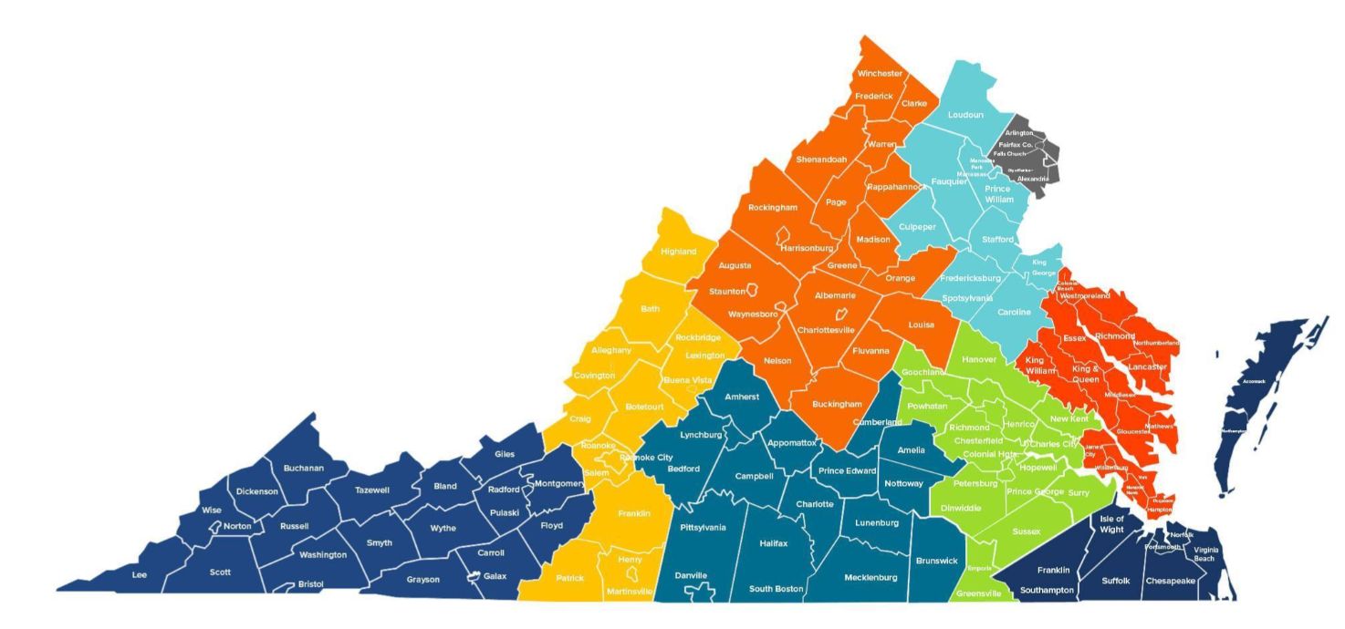
Ready Regions for Virginia
Ready Regions are providing VQB5 coordination, accountability, and family engagement for early childhood programs in every corner of the state, including supporting programs with the completion of the required VQB5 activities.
Visit the Ready Regions website to find your Ready Region (https://vecf.org/ready-regions/)

Slide 7
VQB5 Participation Requirements

Slide 8
Publicly-Funded Providers: Required Participation
“Publicly-funded provider” means any (i) educational program provided by a school division or local government to children between birth and age five or (ii) child day program that receives state or federal funds in support of its operations that serves three or more unrelated children.
This definition is intended to capture funding sources that support direct early childhood care and educational services for young children. These public funding sources include:
Virginia Preschool Initiative (VPI)
Early Childhood Special Education (ECSE or IDEA Part B, Section 619 preschool)
Title I Preschool
Head Start/Early Head Start
Virginia’s Child Care Subsidy Program
Local government child care assistance, such as Fairfax’s Child Care Assistance and Referral (CCAR) program
Federal Child Care Access Means Parents in School (CCAMPIS)
Virginia Early Childhood Foundation (VECF) Mixed Delivery
Federal Department of Defense Military Child Care Fee Assistance (MCCYN and MCCYN-Plus)

Slide 9
VQB5 Participation Requirements
To meet the participation requirements in the legislation, all publicly-funded programs are required to complete the following three activities each year.
Sites must complete the registration process between August 15-October 1 in LinkB5, the VQB5 data portal.
Sites enter information about their optional use of a VDOE-approved curriculum during registration.
Ready Regions will support programs with the registration process.
Every eligible classroom must complete two local CLASS® observations, one in the fall and one in the spring, with scores entered in LinkB5.
In addition to the two local CLASS® observations coordinated by Ready Regions, all participating sites must participate in external CLASS® observations for each age-level served, between August 15 and May 31.
View 2023-2024 VQB5 Participation Handbook for more information

Slide 10
VQb5 Participation Benefits
Strengthened Quality: Educators and leaders will receive individualized feedback and support.
Training and Support: Educators and leaders will have access to supports, training, and resources to help improve interactions and access to curriculum.
Public Recognition: Quality profiles will be posted publicly starting in the fall of 2024. All programs will receive a certificate.
Financial Recognition for Child Care and Family Day Home Teachers: To assist with providing competitive compensation, eligible educators will receive up to $3,000 through RecognizeB5.

Slide 11
Consequences for Not Participating
The VDOE will take several steps to inform publicly-funded programs that they must participate prior to any enactment of consequences.
Publicly-funded sites that do not complete the registration requirements by October 1 will be notified in writing that they are out of compliance with the law.
Sites will be notified of a time-bound deadline to complete registration in LinkB5 in order to maintain public funding eligibility.
Sites who do not comply with the law after receiving at least two notifications from VDOE may have their current public funding terminated with potential restrictions for future public funding.
VDOE is working with leaders from each public funding authority, including the Department of Defense, to establish additional notification procedures and follow up steps for the 2023-2024 year, with the goal of ensuring programs have the opportunity to meet legislation requirements, and any unintended consequences/burden on families is limited to the extent possible.
Notes:
There will be a specific late-registration process when needed

Slide 12
Quality Measurement and Improvement in VQB5

Slide 13
Measuring Quality
VQB5 measures the quality of infant, toddler, and preschool teaching and learning based on two nationally-recognized quality indicators.
Interactions | Curriculum
Measure teacher-child interactions and instruction in a developmentally-appropriate way using the Classroom Assessment Scoring System (CLASS) | Measure the use of approved curricula that are aligned with Virginia’s Early Learning and Development Standards
Research shows that stimulating and supportive interactions between teachers and children and effective use of quality curricula promote children’s holistic learning and development, resulting in improved school readiness.
Details can be found on the Quality Measurement and Improvement (VQB5) website​

Slide 14
Continuous Quality Improvement
PREPARE
Leaders and educators understand what is being measured and why
RECOGNIZE, REFLECT AND ADJUST
Leaders and educators use data to recognize growth, reflect on what works, and make adjustments to address challenges and gaps
MEASURE AND IMPROVE
All infant, toddler, and preschool classrooms are observed and consistent information is collected to understand the experience of all children
SUPPORT
Leaders and educators receive professional development that addresses their unique classrooms
GIVE FEEDBACK
Leaders provide educators with individualized feedback on their classroom’s strengths and opportunities for growth
Notes:
Lucy
Measurement and Improvement are connected - An important feature of VQB5 is that measurement and improvement are connected and ongoing. VQB5 programs have many opportunities to reflect on their progress during the year using a continuous quality improvement cycle.

Slide 15
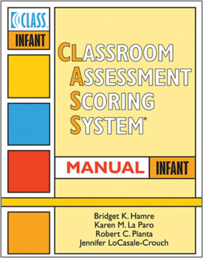
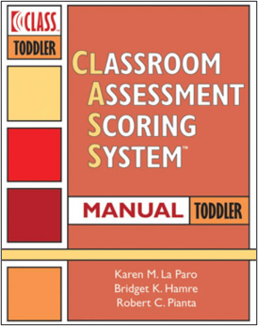
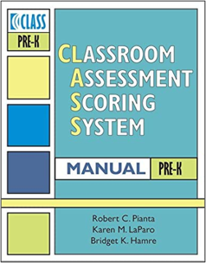
CLASS Tools Used in VQB5
VQB5 uses the Infant, Toddler, and Pre-K CLASS observation tools to assess teacher-child interactions needed to promote child learning and development within each specific age range.
Infant CLASS is used to observe classrooms that serve birth-18 months
Toddler CLASS is used to observe classrooms that serve 15-36 months
Pre-K CLASS is used to observe classrooms that serve 3–5-year-olds
For 2023-2024, VQB5 will use the original 2008 version of Pre-K CLASS.
Mixed Age Settings, such as family day homes, use the CLASS tool that aligns with the age of the majority of children served.

Slide 16
Types of VQB5 CLASS Observations
VQB5 | LOCAL OBSERVATIONS | EXTERNAL OBSERVATIONS
Purpose | Used to gather classroom-level information about the quality of teacher-child interactions and provide individualized feedback. | Used to gather information about the accuracy and consistency of local observations for the state, and to provide an additional source of feedback.
Definition | Coordinated and scheduled at the local level through Ready Regions, with results recorded in LinkB5. | Coordinated, scheduled, and recorded statewide by Teachstone’s external observation team.
Annual Cycle | All birth-to-five classrooms will get two local observations each year. One in the fall and one in the spring. | Only some birth-to-five classrooms will get an external observation. All sites will receive an external observation in at least one classroom for each age-level.
Feedback Process | Local Observer schedules a feedback session with teacher or team of teachers within 10 days of the local observation.​ | Feedback is shared via a written report which is emailed to the primary site administrator 10 days after the external observation.
Through both local and external observations, early childhood educators are better prepared to support children's learning and development.

Slide 17
Use of Curriculum in VQB5
In VQB5, the use of a comprehensive curriculum in alignment with Virginia’s Early Learning and Development Standards (ELDS) ensures that all areas of learning and development are being covered in developmentally-appropriate ways, however the use of an approved curriculum is optional in VQB5*.
The choice to use an approved curriculum in at least one classroom results in some additional points towards the rating displayed on VQB5 Quality Rating. However, this is not required for participation or required for receiving a rating that meets expectations.
Programs that are interested in using an approved curriculum as part of VQB5 may:
Use one of the 50+ approved early childhood curriculum available, including Virginia’s no-to-low-cost curriculum option, STREAMin3 or
Request to have their curriculum of choice reviewed for possible approval.
Curriculum is a key ingredient to helping teachers improve their interactions, providing ways to create nurturing and responsive practices and environments that foster trust, emotional security, and learning.
*VQB5 does not require the use of any curriculum. ​

Slide 18
VDOE Improvement Partners
VDOE funds and works with a variety of improvement partners. These partners are responsible for working with birth-to-five programs to provide training, coaching, or coursework intended to improve the early childhood system, prioritizing supports for VQB5 programs.
Targeted PD Supports for VQB5 programs to Improve Interactions and Curriculum | PD Supports for Child Care Programs to Improve Workforce and Business Practices
Virginia Infant Toddler Specialist Network (VA-ITSN) Advancing Effective Instruction and Interactions (AEII) Training and Technical Assistance Centers (TTAC) VCU Autism Center for Excellence Early Childhood Early Childhood Mental Health Consultation STREAMin3 Curriculum Model and PD Support CLASS Observer Training (Online VDOE trainings and trainings offered by Ready Regions) Foundational CLASS Training offered by Ready Regions | Early Learning Standards Microcredential Virginia Child Care Provider Scholarship Program Community College Workforce Alliance (CCWA) Early Educator Fast Track Initiative Better Kid Care-Penn State Extension Child Care Aware of Virginia (Child Care Resource & Referral – CCR&R)
Available for free to all VQB5 Programs, with certain PD supports prioritized for VQB5 Publicly-Funded Programs | Available for free to all Child Care Programs in Virginia

Slide 19
VQB5 Public Quality Profiles

Slide 20
VQB5 Annual Timeline
VQB5 uses an annual measurement and improvement cycle summarized below. Results from VQB5 measurements gathered in the fall and the spring are used to determine the VQB5 annual Quality Rating. The first public VQB5 Quality Ratings will be shared in the fall of 2024.
Summer | Fall | Winter | Spring
Program registration and preparation for fall CLASS observations. *Registration: August 15-October 1 | Local CLASS observations and curriculum use information for every classroom entered in LinkB5. | Programs use information from fall to engage in professional development based on program and classroom needs. | Local CLASS observations and curriculum use information updated (if needed) for every classroom entered in LinkB5.
Reflect and Prepare
Measurement, Feedback, and Support for Every Classroom
External CLASS observations are used at every site to gather information, support local observers, and provide additional feedback.
Notes:
Lucy

Slide 21
VQB5 Quality Ratings
VQB5 Quality Ratings will be calculated at the end of the academic year using the following point system. Quality Ratings from the 2023-2024 year will be posted publicly in the fall of 2024.
Interactions Points (700 total points) | Average of all local CLASS scores from the fall and the spring (all classrooms at a site) x 100*
Curriculum Points (100 total points) | Programs using an approved curriculum in at least one classroom, by May 31st, will receive 100 points added to their score
Total Points | Interactions Points + Curriculum Points = Total Points
Quality Ratings | Exceeds Expectations = 700 - 800 points Meets Expectations = 400 - 699 points Needs Support = 100 - 399 points
*If there are significant discrepancies between comparable local and external scores, a score replacement protocol will be used when calculating the interaction points for the total as outlined in Section 6.2.1 in the VQB5 Guidelines.
Notes:
Lucy

Slide 22
VQB5 Quality Profiles
As established by the Board of Education, all VQB5 participating sites will receive an annual VQB5 quality profile which will include information about performance on measurements (i.e., quality rating results) and other topics of interest to families, policymakers, and the general public.
In accordance with state and federal legislation, and as directed by the Board of Education, VQB5 Quality Profiles must:
Provide parents and families information about the quality and availability of providers by Fall 2024 (state law)
Meet the federal requirements for a child care consumer-friendly website to serve as a resource for families (federal regulation)
Be approved by the Virginia Board of Education
Be scalable for up to 4,000 sites/12,000 classrooms
Clearly articulate levels of quality and improvement over time

Slide 23
Timeline for VQB5 Quality Profile Development
This year, VDOE will lead an interactive process with families, practitioners, and stakeholders to engage the field in the development of VQB5 quality profiles.
Spring 2023
Draft Practice Year 2 Profile Prototypes shared and feedback gathered from the field. Website vendor secured.
Summer 2023
Practice Year 2 profiles finalized based on measurements from 2022-2023 year.
Winter - Spring 2024
New VQB5 Website developed; Mock-ups of Quality Profiles shared with families and the field for feedback; BOE to approve final profile.
Summer 2024
Fall 2024
Quality Profiles posted publicly on new VQB5 website.
Profiles finalized based on measurements from 2023-2024 program year.
Fall 2023
PY2 profiles shared privately with sites. Sites will have opportunity to provide feedback.
VDOE will inform families about VQB5 Quality Profiles.

Slide 24
Next Steps

Slide 25
Next Steps
VQB5 Registration opens next Tuesday, August 15th, 2023.
Connect with your Ready Region
Ready Regions will support registration in the LinkB5 data portal.
Registration must be completed by October 1st.
Prepare for fall CLASS observations in every birth-to-five classroom
The fall observation window is August 15th-December 22nd.
Ready Regions can provide free CLASS training options.
Review the VQB5 Participation Handbook for 2023-2024

Slide 26
Questions?
vqb5@doe.virginia.gov
Keep up to date with VQB5 by signing up for the VDOE monthly e-newsletter Readiness Connections

